Slide 1


IronPython… OMFG
+

Slide 2
Outline
Warning: C# and Python code ahead!
Motivation
Down the rabbit hole
Weaponization
Demo
Conclusion

Slide 3

whoami
Marcello
@byt3bl33d3r
Python fanatic
https://github.com/byt3bl33d3r

Slide 4
Why u do dis?
1.

Slide 5

Offensive PowerShell
It ded Jim (sorta, I guess it’s more like a zombie)
Windows 10 & PowerShell >= v4
AMSI
Constrained Language Mode
Module/ScriptBlock/Transcription Logging

Slide 6
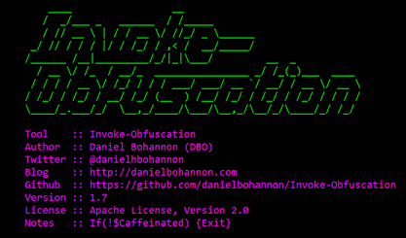
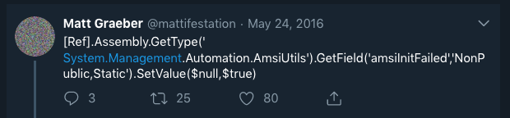
How do we get around this?
You can obfuscate
You can use some of the AMSI/Logging bypasses
You need to obfuscate the bypasses
Use PowerShell V2
C#!

Slide 7
The great C# tooling migration of 2018
Pros
It’s by far is the most direct & immediate tradecraft solution
.NET framework is tightly integrated within Windows
Cons
It’s a compiled and strongly typed language
.NET Version Woes
It ain’t Python or PowerShell

Slide 8
I just want something that works (and is a scripting language)

Slide 9
Can I execute Posh code without worrying about any of these defenses?

Slide 10


Slide 11
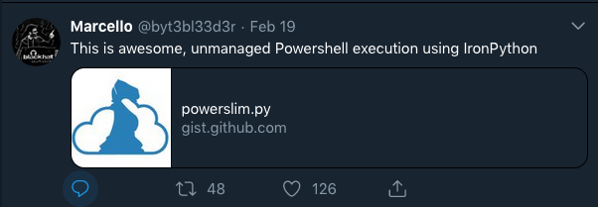
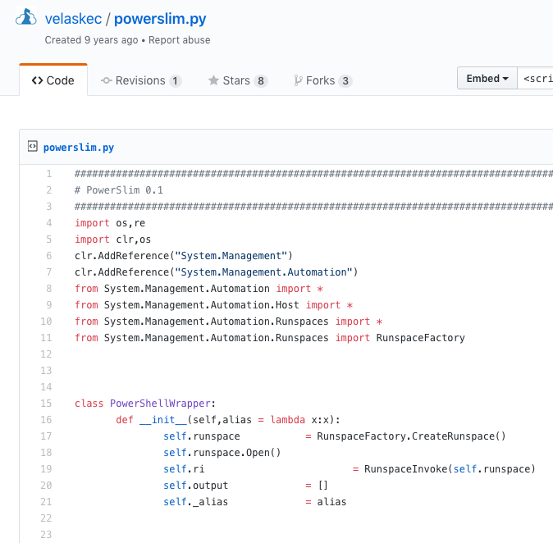
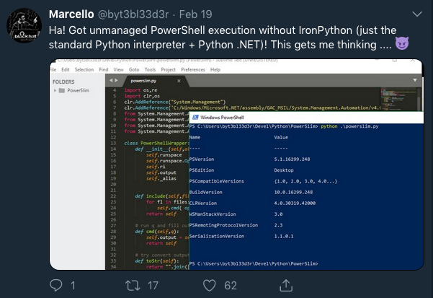
https://gist.github.com/velaskec/315620

Slide 12

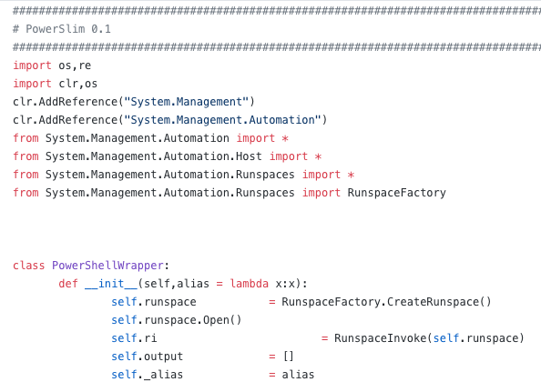

I’ve seen this before…

Slide 13
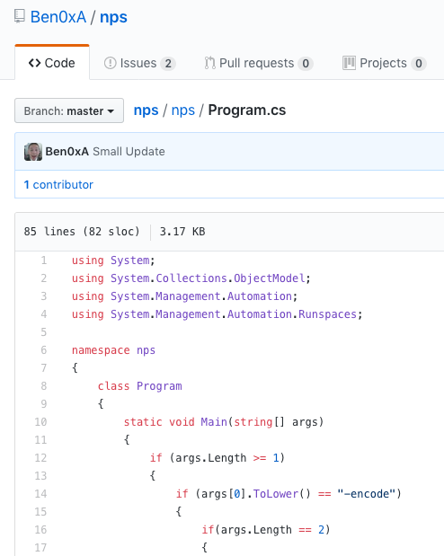
https://github.com/Ben0xA/nps

Slide 14


==

Slide 15
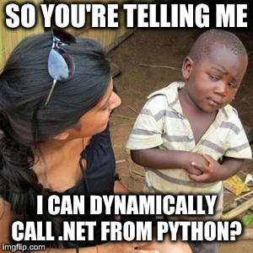
The power of PowerShell, without going through PowerShell and in Python?
Did I just die and go to heaven?

Slide 16
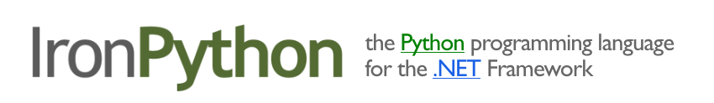
Enter

Slide 17
Down the rabbit hole
2.

Slide 18
Technical Challenges
Learn C#
Setting up an IPY dev environment
Get IPY scripts to run natively on windows?
Possibly compile IPY scripts?

Slide 19
Goal:
Dynamically execute IPY scripts natively on Windows
(Scripted interface to .NET!!!!)

Slide 20


Womp Womp

Slide 21
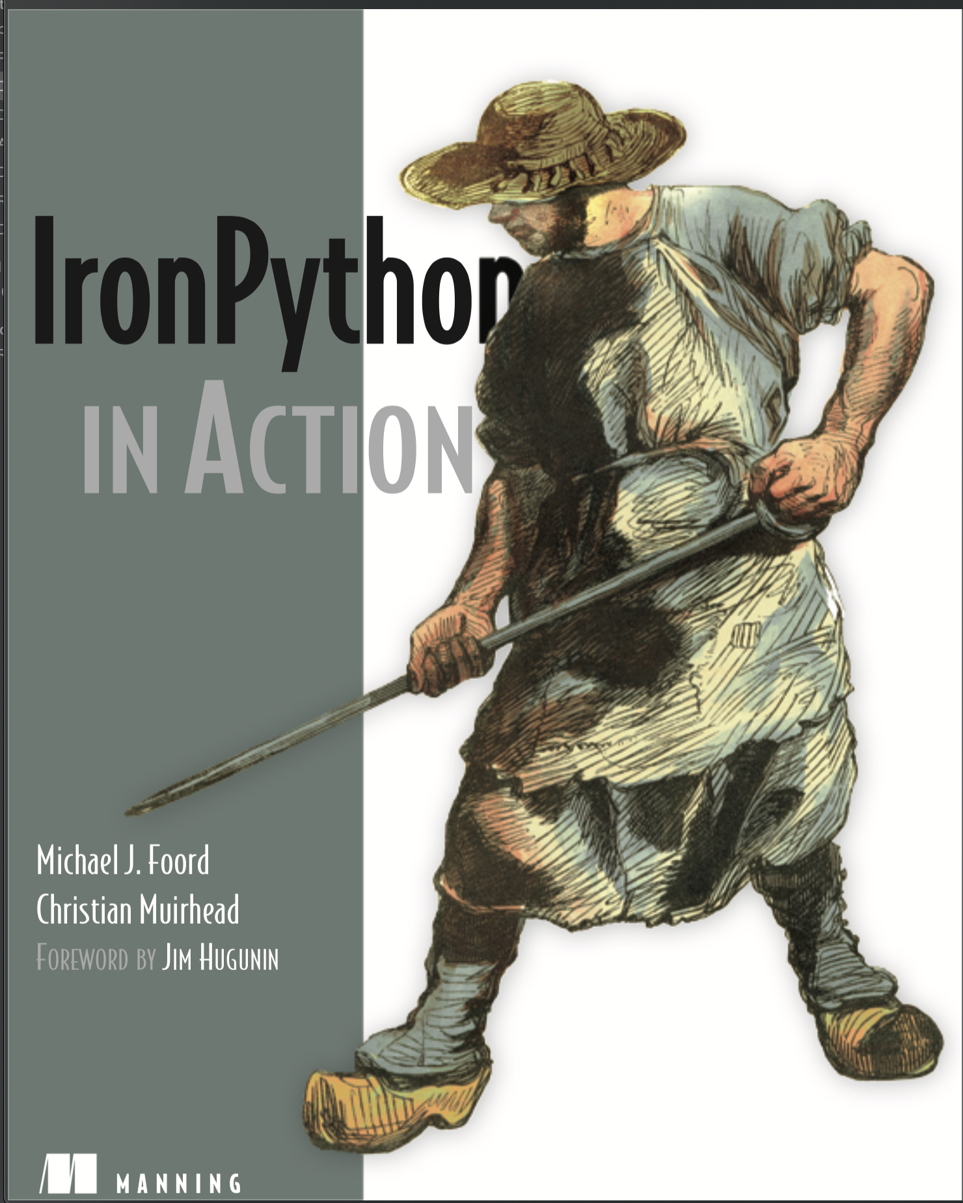

Slide 22
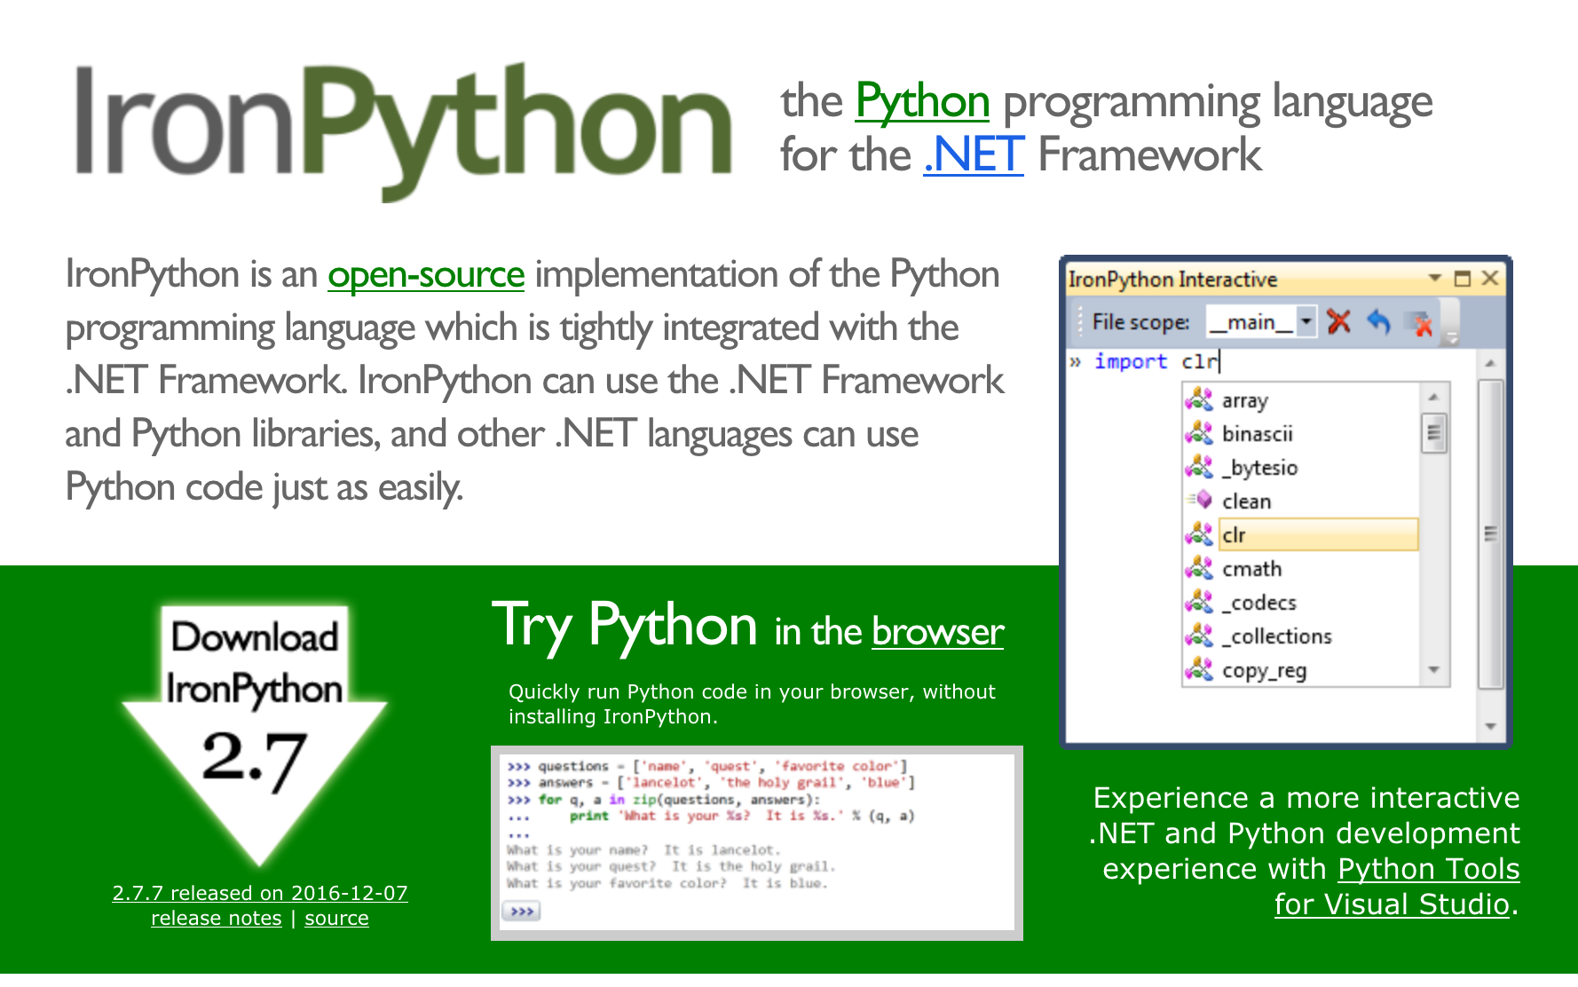


Slide 23
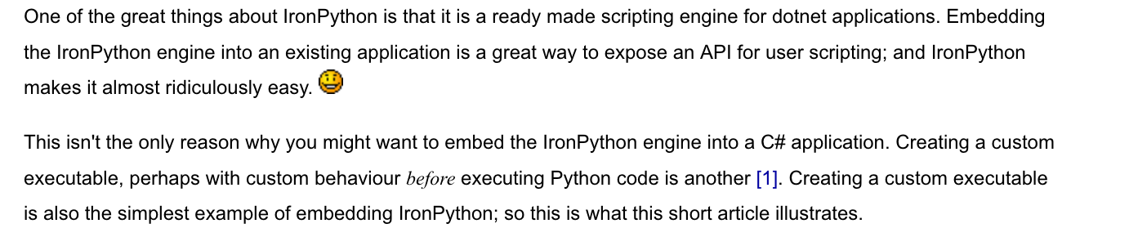
Embedding IPY?
http://www.voidspace.org.uk/ironpython/custom_executable.shtml

Slide 24
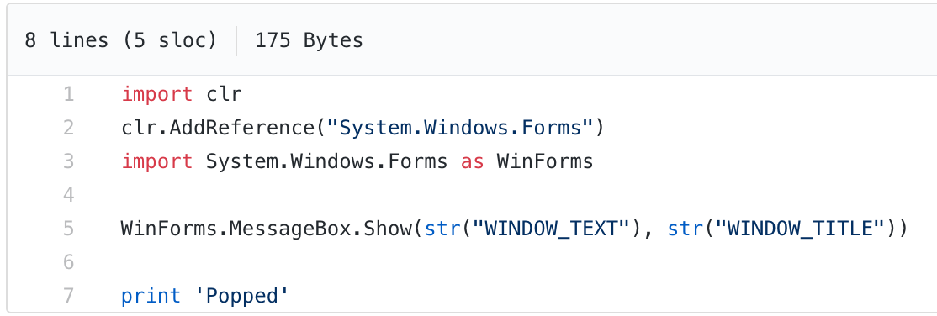

Slide 25
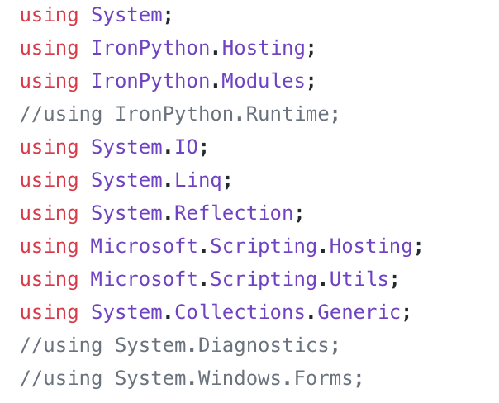
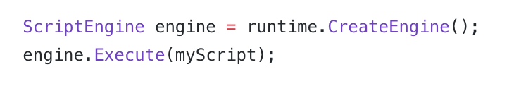
IronPython.dll
IronPython.Modules.dll
Microsoft.Dynamic.dll
Microsoft.Scripting.dll
Your Python script

Slide 26
Embed that bad boy
Cool!

Slide 27
Technical Challenges
Learn C# (Work in progress)
Setting up an IPY dev environment
Get IPY scripts to run natively on windows? ( We can embed the IPY engine in a C# binary/.NET Assembly!)
How do we give access to the Python stdlib to our embedded script?
Needs third party DLLs
Compile IPY scripts? (Not possible through known usual methods)

Slide 28
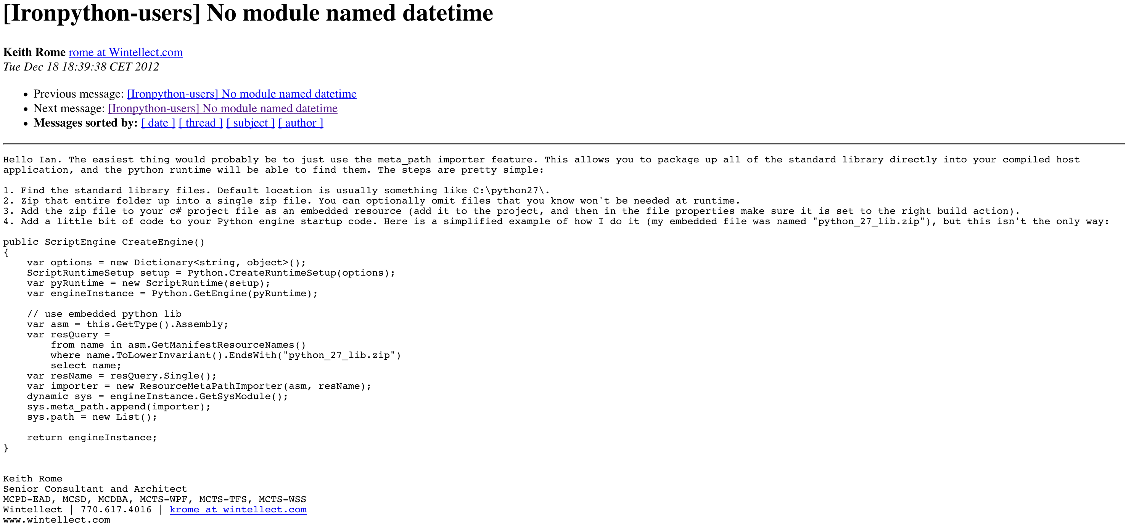
https://mail.python.org/pipermail/ironpython-users/2012-December/016366.html

Slide 29
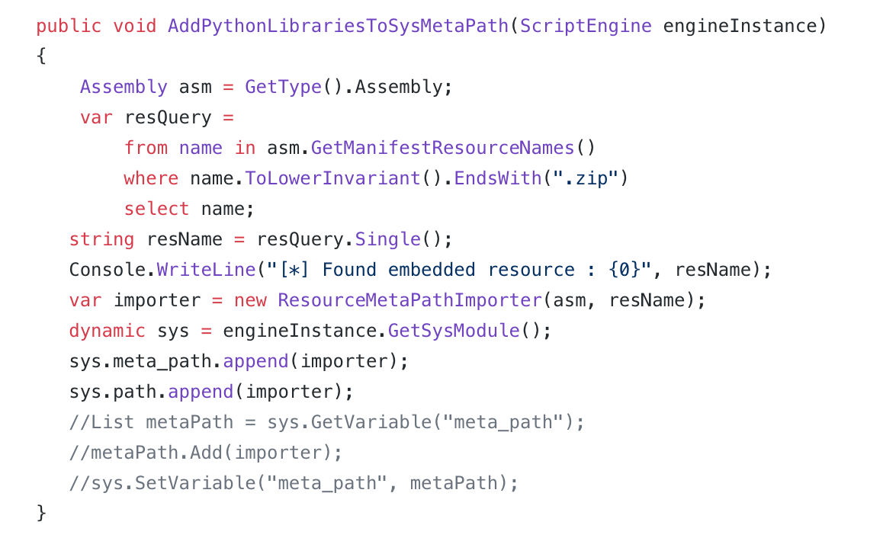
Zip the IPY standard library up
Add the zip file as an embedded resource
Add the following function to our code:
Our IPY engine instance
Get our embedded stdlib zip file
The Magic Sauce
Add the stdlib to the sys.path of our engine

Slide 30
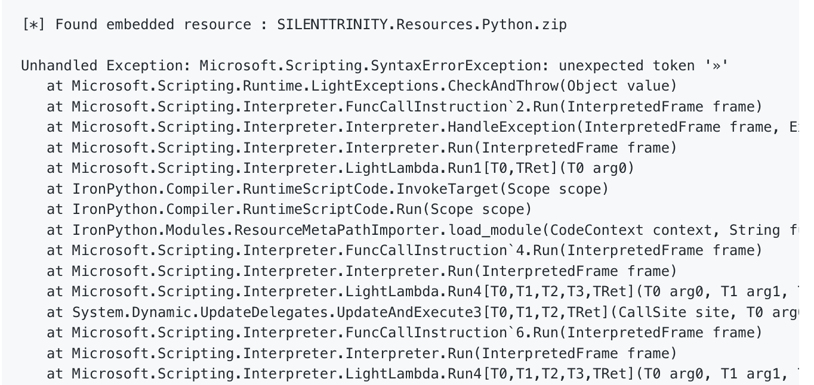
Womp Womp

Slide 31


Slide 32
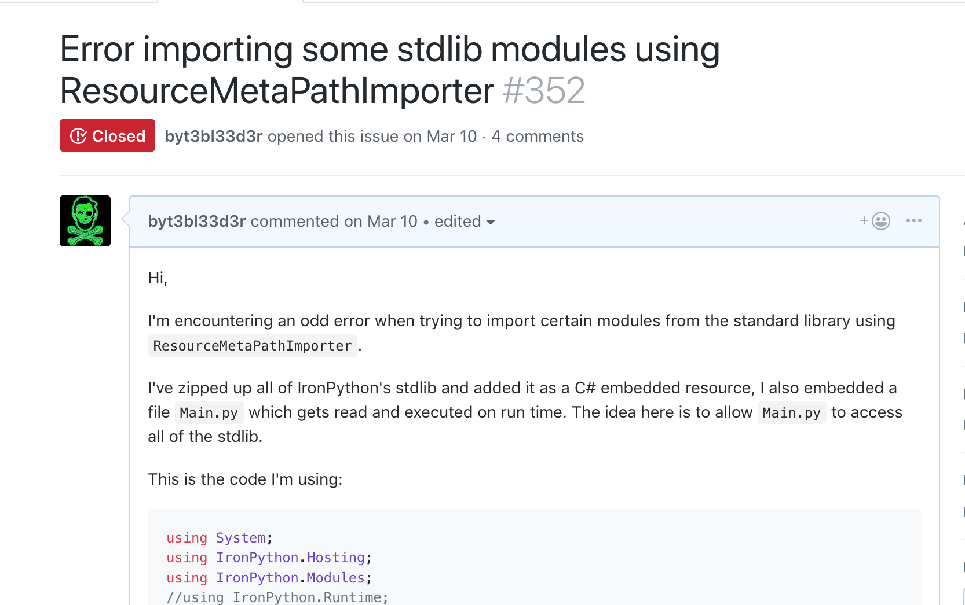

Slide 33
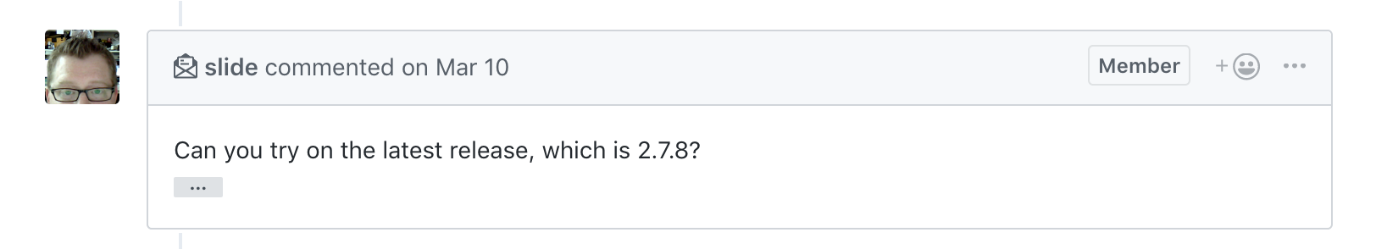
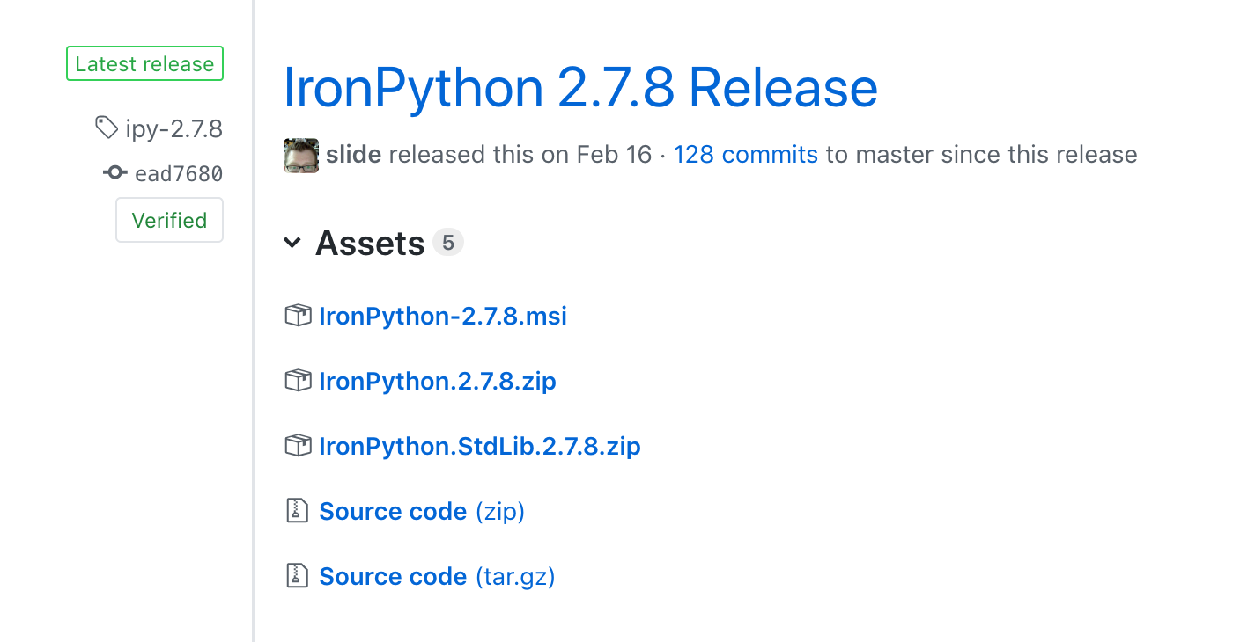

Slide 34

But hey! It works now!

Slide 35
Technical Challenges
Learn C# (Work in progress)
Setting up an IPY dev environment
Get IPY scripts to run natively on windows? ( We can embed the IPY engine in a C# binary/.NET Assembly!)
How do we give access to the Python stdlib to our embedded script?
Needs third party DLLs
Compile IPY scripts? (Not possible through known usual methods)

Slide 36
ILMerge!
Womp Womp

Slide 37
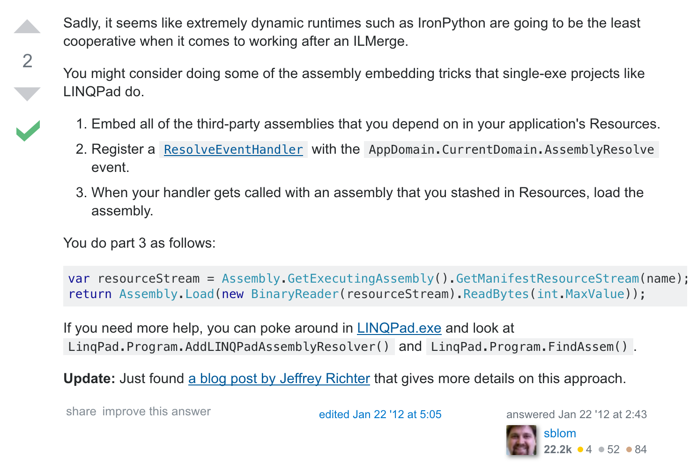
Wat
https://stackoverflow.com/questions/8955268/using-ilmerge-with-ironpython

Slide 38

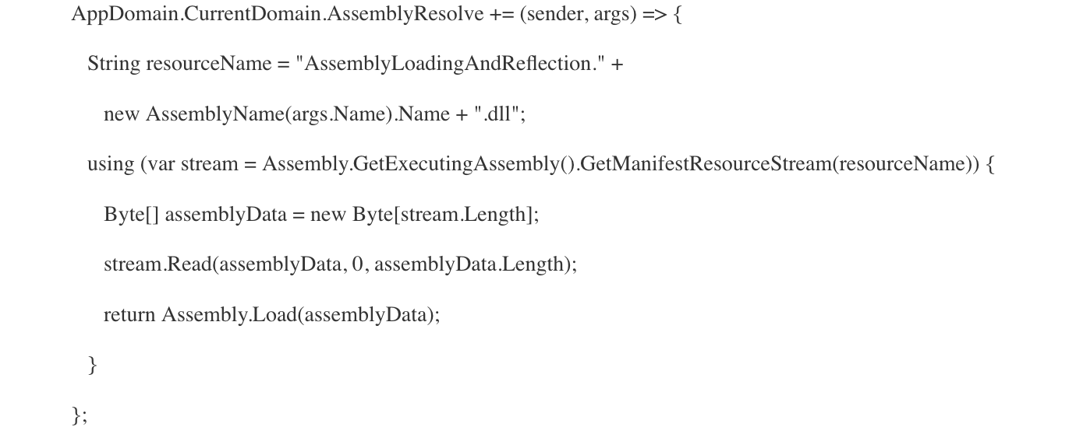
https://blogs.msdn.microsoft.com/microsoft_press/2010/02/03/jeffrey-richter-excerpt-2-from-clr-via-c-third-edition/

Slide 39
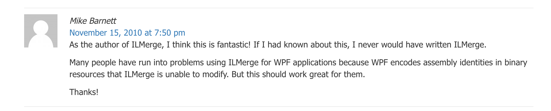
So… What’s the point of using ILMerge anymore?

Slide 40
Technical Challenges
Learn C# (Work in progress)
Setting up an IPY dev environment
Get IPY scripts to run natively on windows? ( We can embed the IPY engine in a C# binary/.NET Assembly!)
How do we give access to the Python stdlib to our embedded script?
Needs third party DLLs
Only works on .NET > v4.0
Compile IPY scripts? (Not possible through known usual methods)

Slide 41
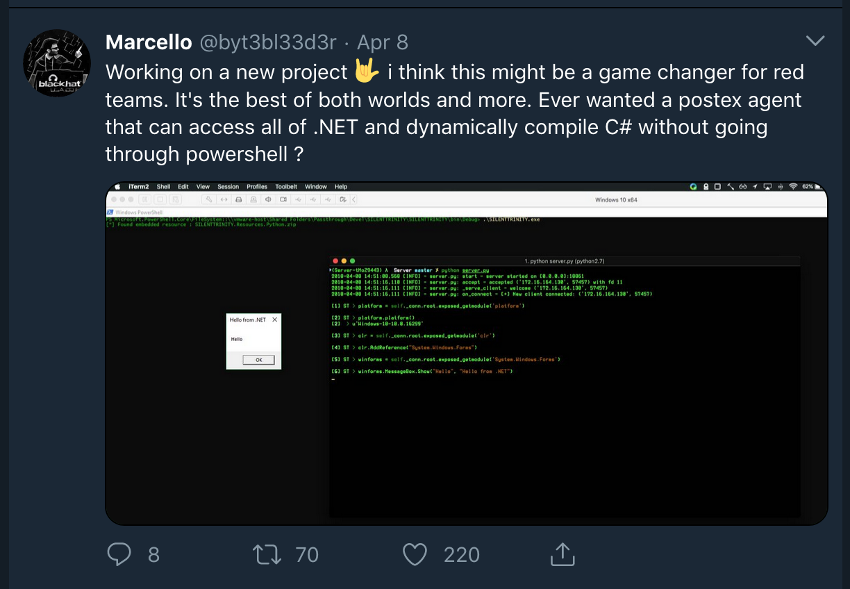

Slide 42
Cool stuff we discovered along the way
Better way of creating Python executables for Windows!
A lesser known way (but much better!) of creating a single EXE that depends on third party Assemblies
From a development standpoint… this is amazing!
Native IPY script execution on Windows 10 through an embedded IPY engine in a C# binary! <- Our Goal!

Slide 43
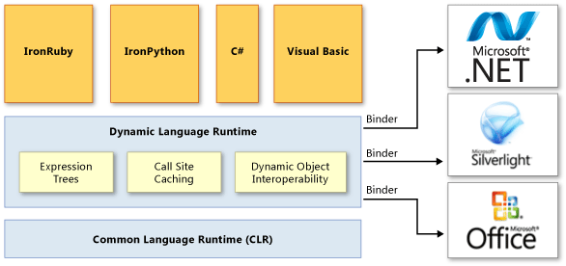
How is this even possible?
https://docs.microsoft.com/en-us/dotnet/framework/reflection-and-codedom/dynamic-language-runtime-overview

Slide 44
Weaponization
3.

Slide 45
Mo Progress Mo Problems
Learn C# (Work in Progress)
File size
The binary with embedded stdlib is ~15 MB (~8MB with max compression level)
Opsec
Preferably want nothing to touch disk
Can we get it to work on .NET < v4.0 ?
Port some of the existing C# tooling over IPY
Data type conversions between IPY <-> C#

Slide 46
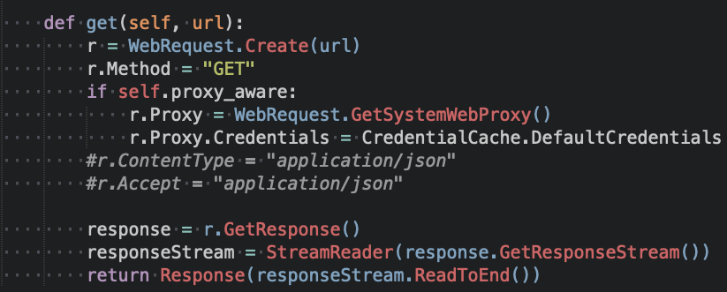
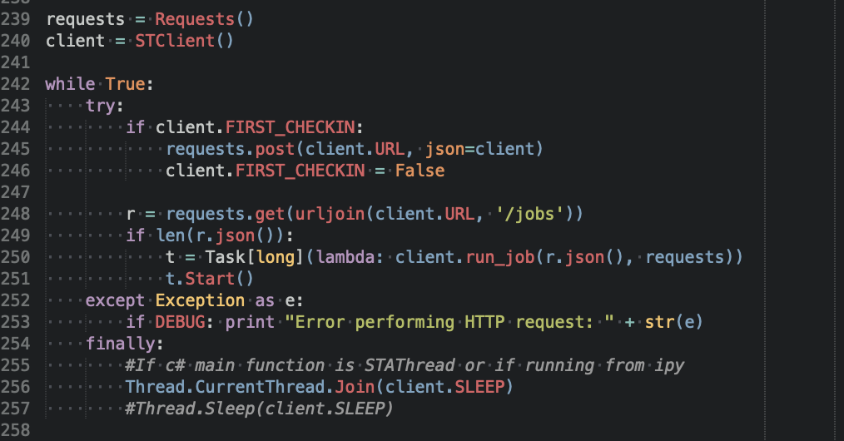
Do we really need the Python Stdlib?
It would be nice in the long run. But, we have access to .NET!
We could stream it down over the network If needed
From 15MB to 10KB!

Slide 47
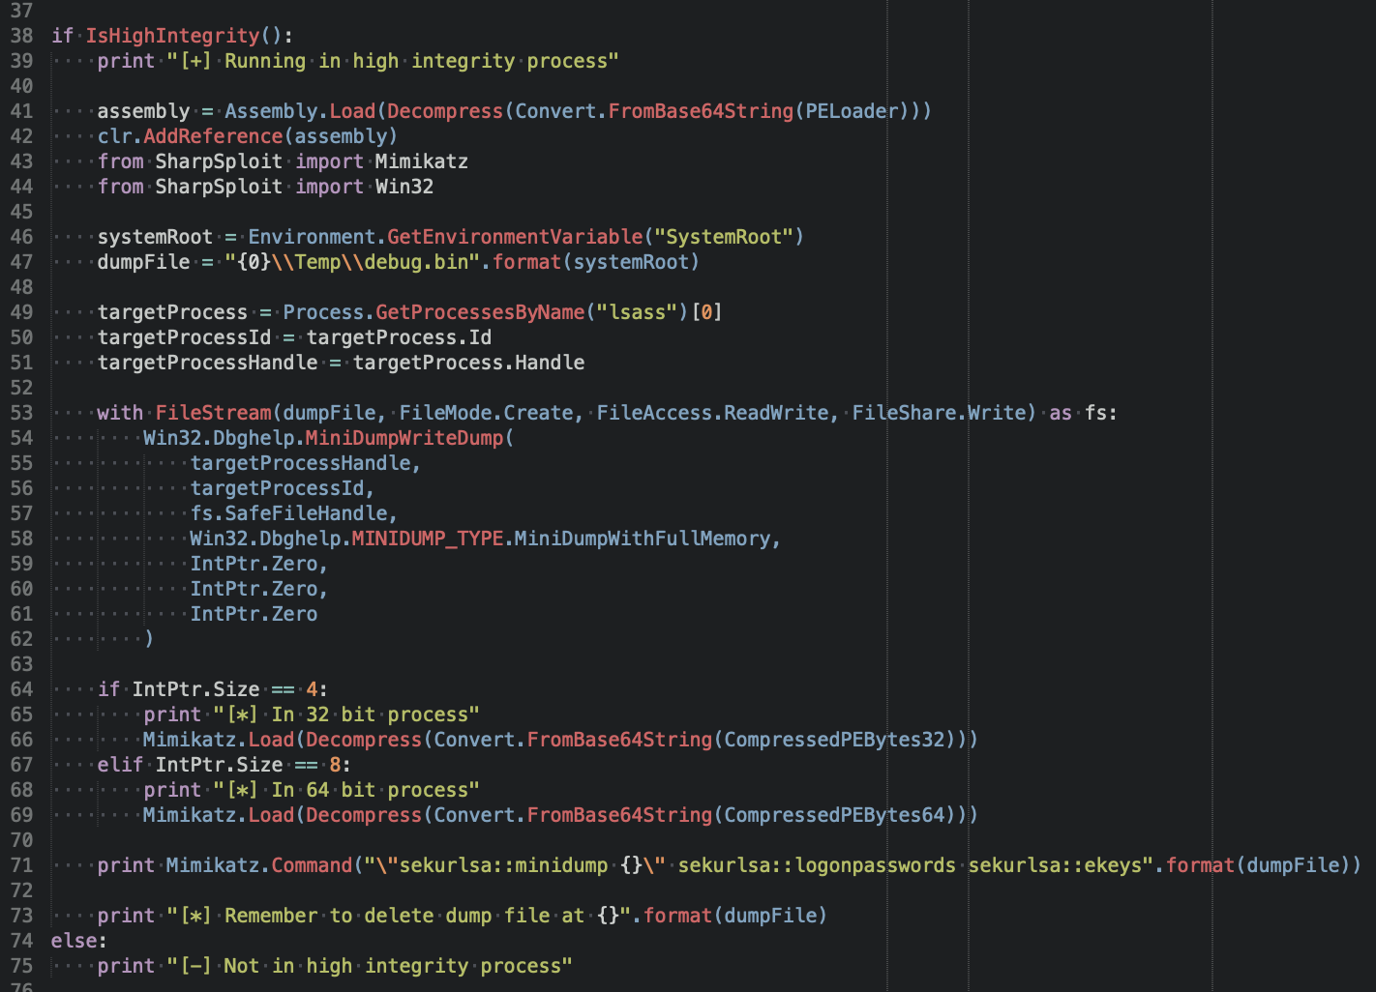
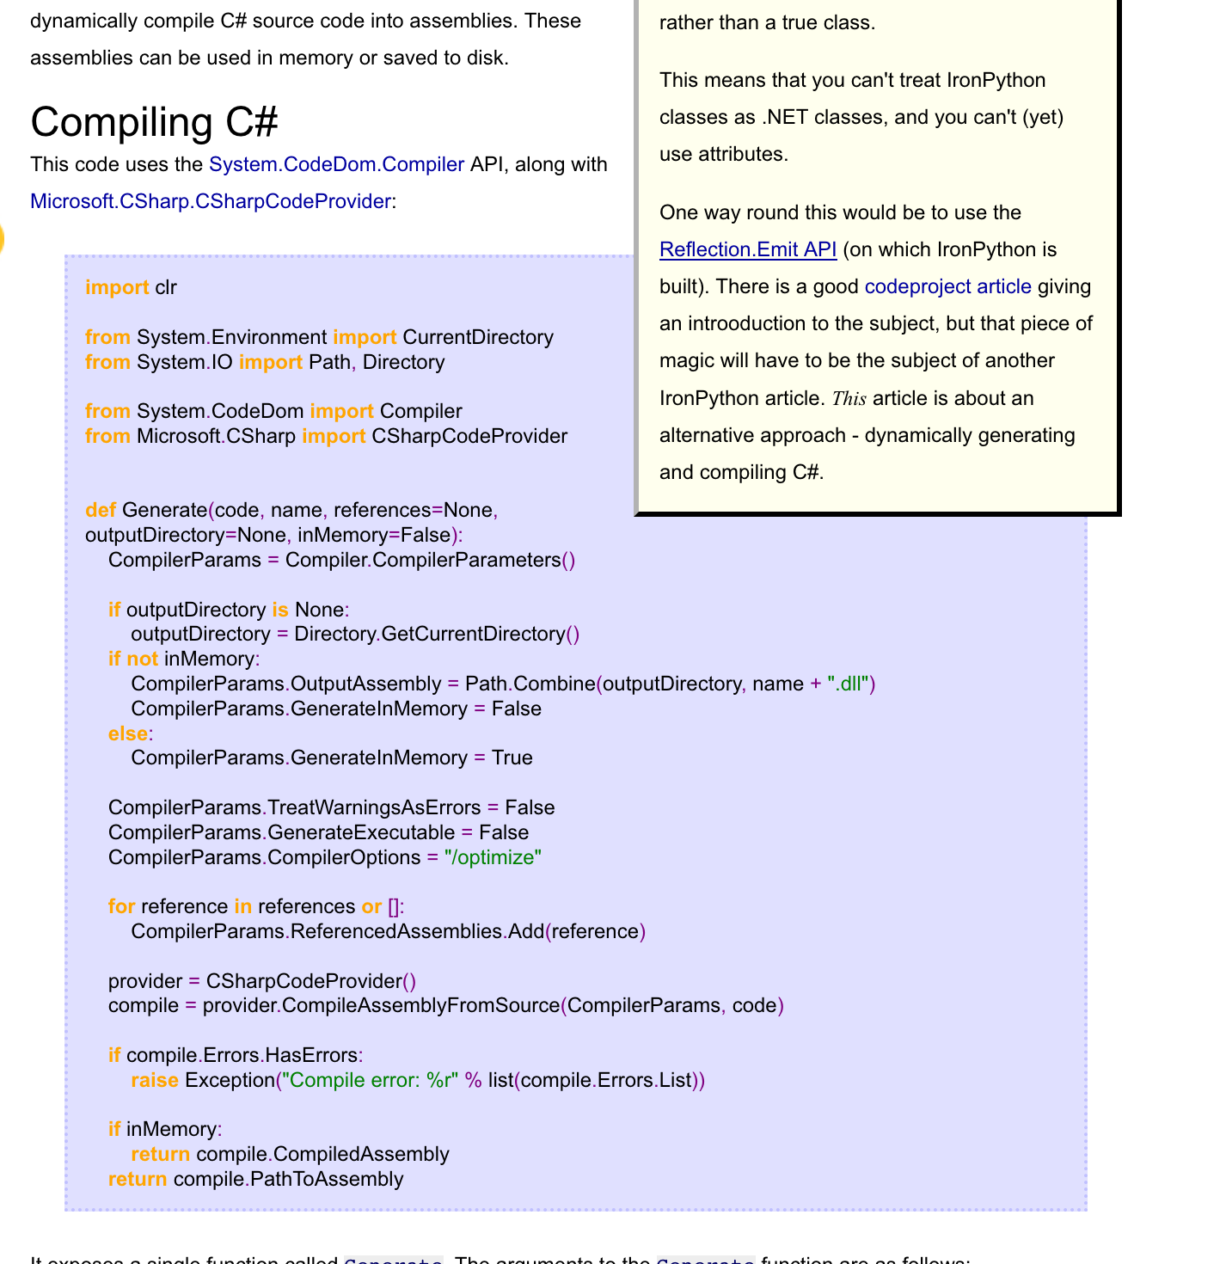
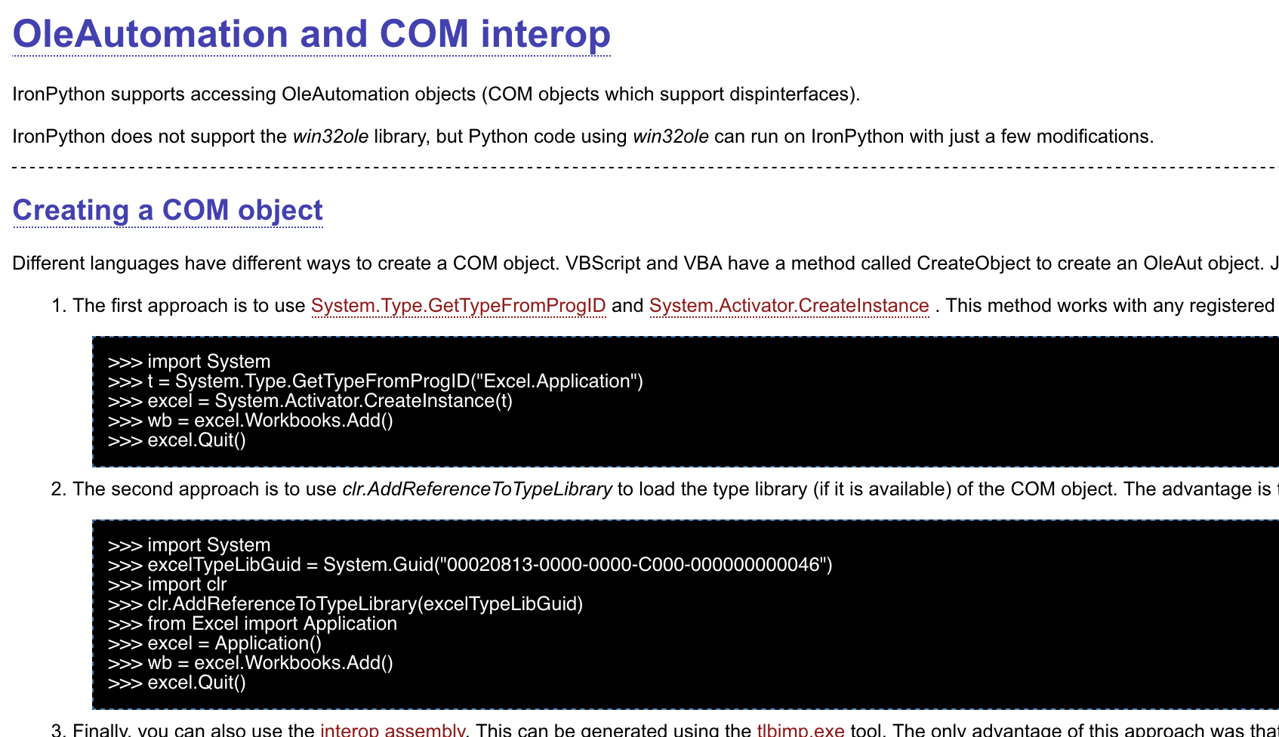
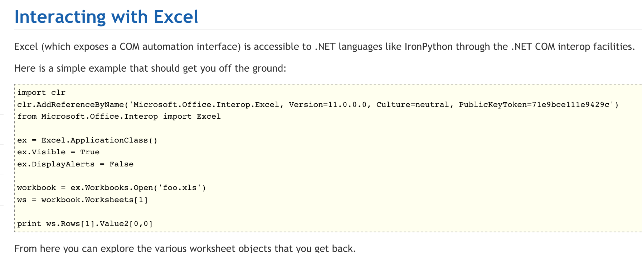
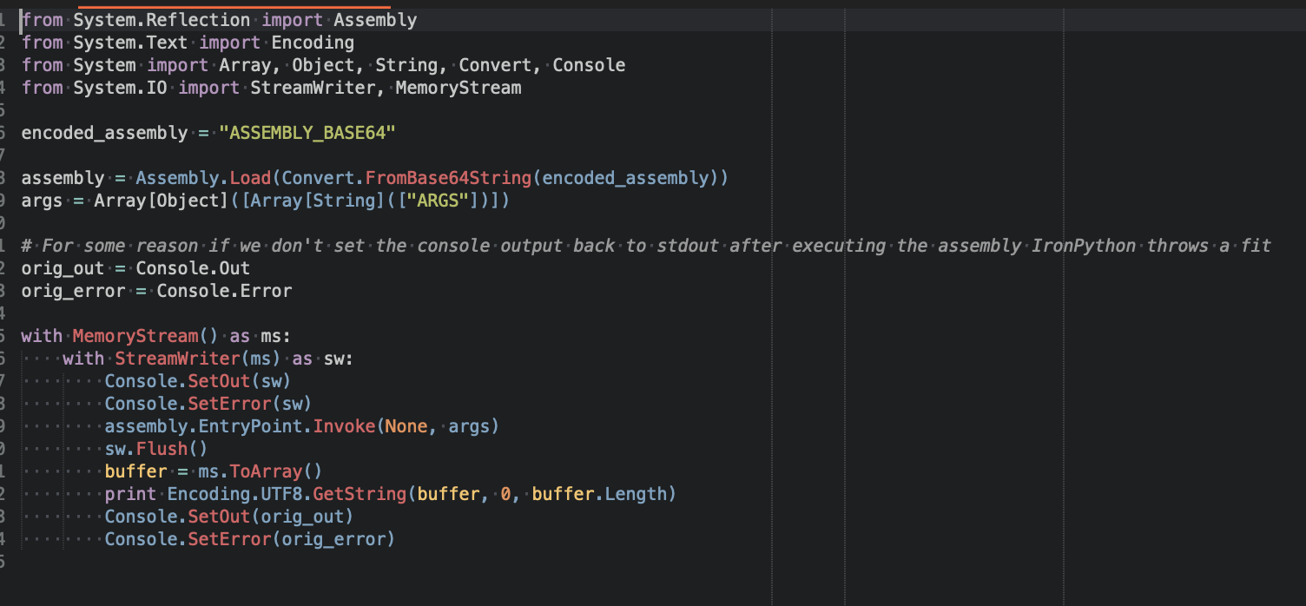
Look ma’ ! No PowerShell!

Slide 48
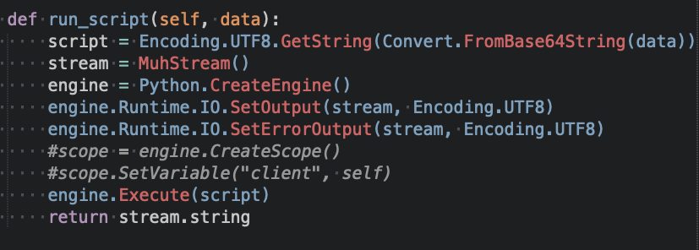
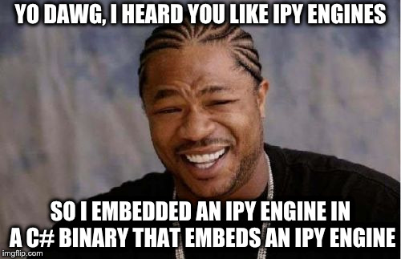
IPY Engine Inception

Slide 49
Holy ****
0 optics into the CLR/DLR
Blows through Windows Defender and most EDR’s like a breeze
Massive amounts of reflection
Payload is decoupled from execution
Your actual payload logic resides only in memory
Everything is dynamic and scriptable, productivity ++
You’re just sending a .PY file over the wire

Slide 50
Holy **** Pt 2
It’s a .NET assembly!
Massive amounts of staging flexibility, DotNetToJS, MSBuild etc..
Each “job” is run in it’s own isolated IPY engine, needed assemblies for the job are removed after execution
Even more stealth
All of the recent C# tooling can be easily ported over to an IPY script either via dynamic C# compilation or native IPY

Slide 51


Slide 52
Detection
Defense in Depth! (App whitelisting, egress filtering etc…)
Not really a lot to detect on (if IPY payloads you’re running are instrumented properly)
Anything with the IronPython DLLs ?
Temp DLLs compiled via CodeDom (fragile)
Microsoft please add optics into .NET!

Slide 53
Prior Work
Quick Retooling in .NET for Red Teams – Circle City Con
Dimitry Snezhkov (@Op_Nomad)
https://github.com/dsnezhkov/typhoon
One of the best red team talks of 2018!!!

Slide 54
Future work
More comms!
Server already supports HTTP/2 & WS, Catch up .NET!
More modules!
RESTful API (Port DeathStar over!)
Make it work on .NET < v4.0
Python object proxying (RPC) ?

Slide 55
Need some more IPY Action?
Tomorrow! 9:00am – 9:50am (Track 1)
Building an Empire with (Iron)Python – Jim Shaver

Slide 56
Credits
@cobber_io
@Op_Nomad
@egyp7
@xorrior
@gentilkiwi
@subtee
@enigma0x3
@mattifestation

Slide 57
https://github.com/byt3bl33d3r/SILENTTRINITY
Any questions?
You can find me at
@byt3bl33d3r
byt3bl33d3r@pm.me

